Slide 1
Equifax Data Breach (2017) Apache Struts – Group B
Shauna Kirwan Kelly - 23442262
Shemen Eroje - 23337261
Virginiah Nganga - 22248781
Linru Wang - 231771521

Slide 2
Equifax Background
Equifax is one of the largest credit reporting companies in the world, that collects and manages personal and financial data.
Equifax collects, stores and analyses information about individuals and businesses, such as social security numbers, credit history and payment records.
Shauna

Slide 3
What was the incident about? What was compromised?
In 2017, Equifax, one of the largest consumer credit reporting agencies suffered a data breach.
This data breach is considered one of the most devastating cyberattacks in history.
Equifax stored information on over 800 million people, and 88 million businesses worldwide.
Bals, F. (2017) Equifax, Apache struts, and CVE-2017-5638 vulnerability: Black duck blog, Equifax, Apache Struts, and CVE-2017-5638 Vulnerability | Black Duck Blog. Available at: https://www.blackduck.com/blog/equifax-apache-struts-vulnerability-cve-2017-5638.html (Accessed: 02 October 2025).
Shauna

Slide 4
What was the incident about? What was compromised?
The breach exposed highly sensitive information, such as birth dates, addresses, and social security numbers of approximately 145 million people.
Over 200,000 people's credit card information was exposed.
This was a huge data breach which affected many people's financial security and privacy.
Breachsense (no date) Equifax Data Breach Case Study: Causes and aftermath., Breachsense. Available at: https://www.breachsense.com/blog/equifax-data-breach/ (Accessed: 02 October 2025).
Shauna

Slide 5
How was the attack conducted?
The hackers gained access to Equifax's network by exploiting the CVE-2017-5638 vulnerability on their website.
CVE-2017-5638 is a massive security flaw that allowed hackers to run commands on a server without permission.
This happens when the server mishandles file upload headers. Hackers could send a request that allowed them to take control of the server.
Sally (2023a) Apache struts statement on Equifax Security Breach, The ASF Blog. Available at: https://news.apache.org/foundation/entry/apache-struts-statement-on-equifax (Accessed: 02 October 2025).
Shauna

Slide 6
How was the attack conducted?
Once inside the servers, the hackers then moved on to other servers within the network, due to a lack of proper network segmentation (a network split into multiple parts, making it harder to reach information).
The hackers found plaintext credentials, this allowed them to access even more servers, and access more sensitive information.
Equifax data breach: A look at how it happened (no date) Mozilla. Available at: https://www.mozilla.org/en-US/products/monitor/equifax-data-breach/ (Accessed: 02 October 2025).
Shauna

Slide 7
How was the attack conducted?
After that, the hackers accessed multiple databases, with more sensitive information on millions of people.
When transferring data, they encrypted the files, which made it harder for Equifax to detect a breach.
Shauna

Slide 8
How was the attack conducted?
Equifax couldn't see that the data was leaving their network due to an expired TLS certificate (a digital file used to enable secure communication between a web server and the user's browser protecting data such as login and payment details), this prevented encrypted traffic from being analysed.
When they renewed the certificate, the suspicious activity was immediately noticed, and they began an investigation and discovered the breach. Soon after this they went public about the breach.
Shauna

Slide 9
Timeline of Events
Mar. 2017
In March of 2017, Apache Software reported a vulnerability and released a patch to Apache Struts .The department of Homeland Security notified Equifax about the vulnerability.
May 2017
In May 2017, the hackers exploited the vulnerability in the network, and they then moved across the network.
May–July
In May-July, the hackers then accessed the databases and encrypted the data when it was being transferred.
End of July
In the end of July, Equifax discovered their TLS certificate was expired, they renewed their certificate and discovered the databreach.
Sep. 2017
In September2017, Equifax announced the breach.
Shauna

Slide 10
Timeline of Events
Mar. 2018
In March of 2018, Equifax announced that an additional 2.4 million individuals had their information stolen
June 2019
In June 2019, Equifax entered a settlement with the FTC (Federal Trade Commission), and the CFPB (Consumer Final Protection Bereau).
Jan. 2020
In January 2020, the first time that people affected from the breach could submit a claim to get compensated.
Jan. 2024
In January 2024, this deadline was extended, allowing more people to submit a claim, after this no more claims were accepted.
2025
Equifax continues to face legal action and fines today.
Shauna

Slide 11
Consequences of the Equifax Breach
Massive Data Exposure
The personal data of 143 million U.S consumers, which was later corrected to 148million.
Exposed data included names, Social Security numbers, birthdates, addresses, and driver's license numbers.
Credit card numbers for 209,000 customers and 182,000 dispute-related personal documents were accessed.
2. Financial & Settlement Costs
Equifax agreed to a global settlement that included paying at $575 million and possibly up to $700 million.
Part of that was allocated for consumer relief, credit monitoring and identity restoration services.
(No date a) U.S. House of Representatives Committee on Oversight and Government Reform. Available at: https://oversight.house.gov/wp-content/uploads/2018/12/Equifax-Report.pdf/ (Accessed: 06 October 2025).
DAD, T.K. (Acting and Nguyen, S.T. (2025) Equifax to pay $575 million as part of settlement with FTC, CFPB, and states related to 2017 data breach, Federal Trade Commission. Available at: https://www.ftc.gov/news-events/news/press-releases/2019/07/equifax-pay-575-million-part-settlement-ftc-cfpb-states-related-2017-data-breach (Accessed: 06 October 2025).
Shemen

Slide 12
Consequences of the Equifax Breach
Legal and Regulatory Liability/ Lawsuits
Numerous class-action suits and regulatory investigations ensued.
The U.S House Oversight Committee produced a detailed report finding systemic failures in security oversight.
Regulatory penalties and requirements for stronger data protection and reporting were imposed
Reputational Damage & Loss of Trust
Equifax’s credibility was severely undermined (customers, governments, and media criticised internal practices)
The stock value dropped drastically following public disclosure.
(No date a) U.S. House of Representatives Committee on Oversight and Government Reform. Available at: https://oversight.house.gov/wp-content/uploads/2018/12/Equifax-Report.pdf/ (Accessed: 06 October 2025).
DAD, T.K. (Acting and Nguyen, S.T. (2025) Equifax to pay $575 million as part of settlement with FTC, CFPB, and states related to 2017 data breach, Federal Trade Commission. Available at: https://www.ftc.gov/news-events/news/press-releases/2019/07/equifax-pay-575-million-part-settlement-ftc-cfpb-states-related-2017-data-breach (Accessed: 06 October 2025).
Shemen

Slide 13

Consequences of the Equifax Breach
Operational & Leadership Fallout
Key executives (CEO, CIO, CSO) departed in the aftermath.
Equifax had to overhaul many of its security practices, infrastructure and oversight mechanisms.
Increase Risk to Individuals
The exposed personal data increased the risk of identity theft, fraud and misuse of financial and credit information by malicious actors.
(No date a) U.S. House of Representatives Committee on Oversight and Government Reform. Available at: https://oversight.house.gov/wp-content/uploads/2018/12/Equifax-Report.pdf/ (Accessed: 06 October 2025).
DAD, T.K. (Acting and Nguyen, S.T. (2025) Equifax to pay $575 million as part of settlement with FTC, CFPB, and states related to 2017 data breach, Federal Trade Commission. Available at: https://www.ftc.gov/news-events/news/press-releases/2019/07/equifax-pay-575-million-part-settlement-ftc-cfpb-states-related-2017-data-breach (Accessed: 06 October 2025).
Shemen

Slide 14
How the Breach Could Have Been Prevented
Network Segmentation/Isolation
Limited access, such that web-facing components cannot directly interact with the sensitive database, would restrict lateral movement by attackers.
Micro-segmentation (breaking internal networks into smaller trust zones to add further containment)
Strong Encryption & Data Protection
Encrypting sensitive data both at rest and in transit reduces risk even if a breach occurs
Properly protecting credentials, keys, and certificates is vital (avoiding expired or mismanaged SSL certs)
(No date) Applying the lessons from the equifax cybersecurity incident ... Available at: https://cams.mit.edu/wp-content/uploads/2021-06-PUBLISHED-MISQE-Applying-the-Lessons-from-the-Equifax-Cybersecurity-Incident.pdf (Accessed: 05 October 2025).
Shemen

Slide 15

How the Breach Could Have Been Prevented
Asset & Configuration Management
Maintaining an up-to-date inventory of all systems, their owners, configurations, and dependencies is necessary so nothing is overlooked.
Ensuring systems are properly scanned (not including subdirectories) so vulnerabilities aren’t missed.
Continuous Monitoring, Intrusion Detection & Anomaly Detection
Observing network traffic and alerts in real time helps to detect suspicious behaviour early.
Log management and integrity checking of logs (so attackers can't erase traces) are critical
(No date) Applying the lessons from the equifax cybersecurity incident ... Available at: https://cams.mit.edu/wp-content/uploads/2021-06-PUBLISHED-MISQE-Applying-the-Lessons-from-the-Equifax-Cybersecurity-Incident.pdf (Accessed: 05 October 2025).
Shemen

Slide 16
How the Breach Could Have Been Prevented
Incident Response/ Breach Planning/ Drills
Having a predefined breach response plan with clear roles, escalation paths and communication strategies enables faster containment.
Regular exercise, simulations and post-incident reviews strengthen readiness.
Security Governance, Culture & Oversight
Elevated cybersecurity awareness at board and executive levels helps ensure adequate resources and accountability.
Training employees to recognise phishing, enforce reporting channels, and build a security-conscious culture.
(No date) Applying the lessons from the equifax cybersecurity incident ... Available at: https://cams.mit.edu/wp-content/uploads/2021-06-PUBLISHED-MISQE-Applying-the-Lessons-from-the-Equifax-Cybersecurity-Incident.pdf (Accessed: 05 October 2025).
Shemen

Slide 17
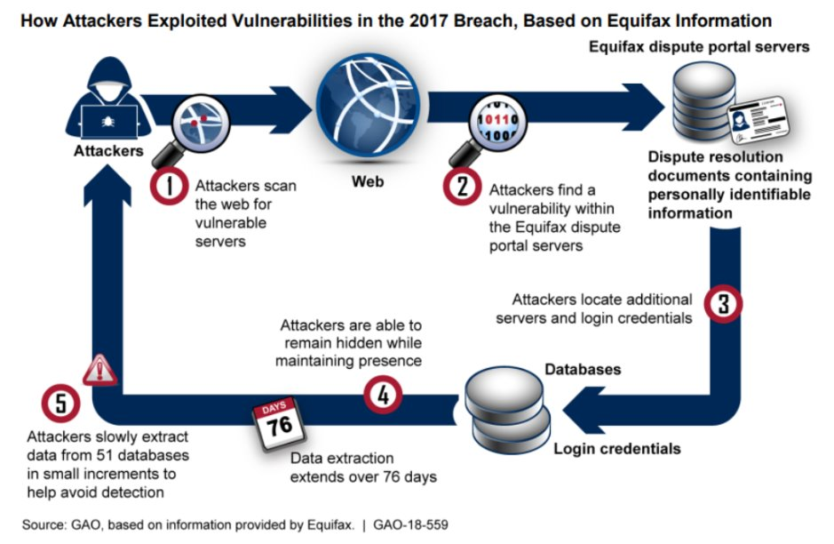
Equifax Cyber Threat
Vulnerability Type: Software vulnerability exploitation (unpatched systems).
Threat vector: Remote Code Execution(RCE).
RCE definition - is a type of security vulnerability that allows attackers to run arbitrary code on a remote machine, connecting to it over public or private networks.
First Appearance of the vulnerability:
March 6, 2017 ; The Apache Software Foundation publicly disclosed the RCE vulnerability (CVE-2017-5638) in Apache Struts 2.
Thomas, J.E., (2019). A Case Study Analysis of the Equifax Data Breach. Available at: https://www.researchgate.net/profile/Jason-Thomas-21/publication/337916068_A_Case_Study_Analysis_of_the_Equifax_Data_Breach_1_A_Case_Study_Analysis_of_the_Equifax_Data_Breach/links/5df2f9804585159aa4793667/A-Case-Study-Analysis-of-the-Equifax-Data-Breach-1-A-Case-Study-Analysis-of-the-Equifax-Data-Breach.pdf. (Accessed: 30 Sept 2025)
Virginiah

Slide 18
Types/ Categories of Remote Code Execution Attacks
Ways of classifying RCE Types By:
Root Cause
input-validation/injection
Unsafe code evaluations
Disclosure Status
Known/unpatched
Zero Day
Exploit Access
Authenticated
Deserialization
Memory corruption
Bad configurations
File upload
Unauthenticated
Trigger / Persistence
Immediate (Reflected) RCE
Stored (Persistent) RCE
Virginiah

Slide 19
Types Explained
1. Memory-corruption RCEs
- Exploits flaws in native code that let an attacker overwrite memory and hijack control flow (return addresses, function pointers).
2. Command Injection / OS Command Execution
- Application constructs shell/OS commands using untrusted input and executes them (e.g., via system(), exec()).
3. Deserialization vulnerabilities
- Unsafe deserialization of untrusted serialized objects allows execution of arbitrary classes/methods.
4. Remote file upload
- Uploading files that are later executed or interpreted by the server.
5. Insecure use of eval / dynamic code execution
- Use of eval() or equivalent on user-controlled input in languages like JavaScript, Python, Ruby etc.
6. Zero-day vs Known-vulnerability RCE
Zero-day: Exploited before vendor knows
Known / unpatched: Vendor has released a patch; the vector is usually poor patch management
7. Immediate (Reflected) RCE: Code executes right away when the malicious input is processed.
8. Stored (Persistent) RCE: Malicious code is saved (example, in a database or file) and executed later when the system processes it.
Virginiah

Slide 20
Recent Apache Struts & Similar Web Application Vulnerabilities
CVE/Vulnerability | Severity (CVSS) | Description/ Impact | Fixed Version
CVE-2024-53677 | 9.8 Critical | Allowed unauthenticated file uploads that could lead to full system compromise. | Apache Struts 6.4.0
CVE-2023-50164 | 9.8 Critical | Path traversal vulnerability — attackers could upload malicious files and trigger Remote Code Execution | v2.5.33 / v6.3.0.2
CVE-2017-5638 | 9.8 Critical | The one that caused the Equifax breach where 147 million personal records were stolen. | v2.5.10.1
Log4j (CVE-2021-44228 “Log4Shell”) | 10 Critical | Java-based framework, affected companies like Amazon and Microsoft. | Apache Log4j 2.15.0 and later
These flaws exploited a key attack vector, compromising critical assets such as user databases
Linru
Apache Struts Vulnerabilities: Latest CVEs And Fixes (tuxcare.com)

Slide 21
Security controls:
Patch and Update Management
Regularly upgrade to fixed versions.
Timely application of security patches (Equifax failed here).
Vulnerability Assessment and Testing
Conduct regular vulnerability scans and penetration tests.
Perform ongoing threat analysis to identify potential vulnerabilities early on.
Secure Development and Governance
Building a security-first culture.
Use secure coding practices.
Deploy a Web Application Firewall to block malicious uploads and RCE attempts.
Linru
Vulnerability and threat management

Slide 22
Conclusion
The Equifax breach shows how important cybersecurity is for protecting sensitive information.
This vulnerability in the outdated software allowed the hackers to access the personal information, showing that small oversights can lead to massive consequences.
This breach caused financial loss, legal action and irreversible damage to Equifax's reputation.
This breach has shown us the importance of following security principles and carry out network monitoring to prevent similar attacks from happening.
Shauna

